Slide 1




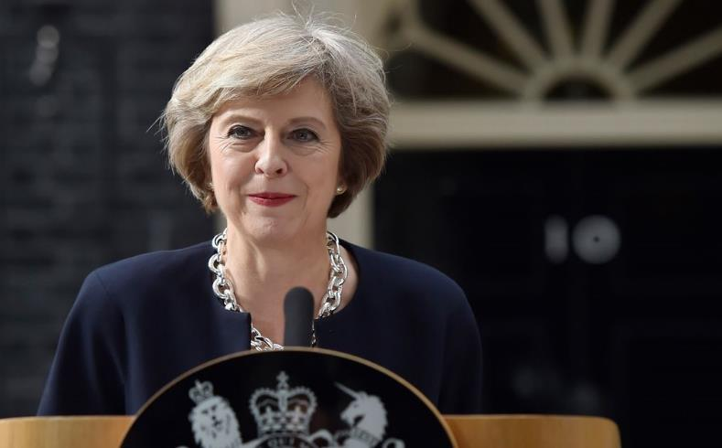


Who are these people and what do they all have in common?
Notes:
They all have Geography in common! Prince William (studied Geography at university), Theresa May (studied Geography at Oxford university), Mother Theresa (taught Geography), Michael Jordan (greatest basketball player of all time - now a businessman worth $1.24bn (studied Geography), Anita Roddick (founder of the Body Shop, an environmentalist and her company is based on strong geographical ideas like fair trade and looking after the environment).

Slide 2
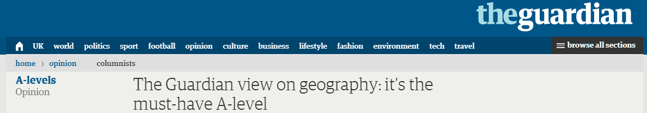
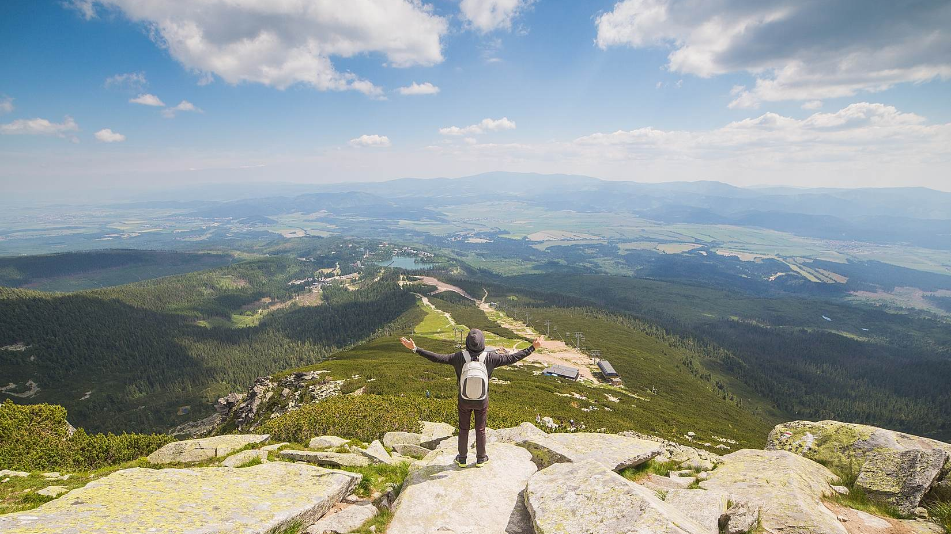
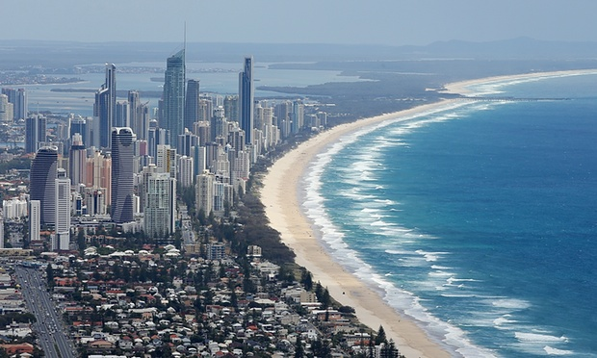
GCSE
GEOGRAPHY
“Geography is all the rage.”
“Geography is a subject for our times.”
“Geography is soaring in popularity.”
Notes:
Geography is one of the most popular option choices at GCSE with over a third of pupils in England taking the subject. Geography is not only up-to-date and relevant, it is one of the most exciting, adventurous and valuable subjects to study at GCSE level. So important, in fact, that the Guardian newspaper in 2015 named Geography as a ‘must-have A-Level’ to help you make sense of the world.
Geography marries together the world of hard scientific fact and process, with human interaction and reaction, through skilful application. That is the strength. We don’t study for the sake of it, we problem solve. We don’t learn skills to sit in a room and stare at them, we go out and fix issues

Slide 3

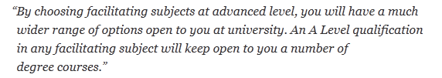
Geography
OPENS DOORS
Geography is a facilitating subject along with Physics, Chem­istry, Biology, Maths and Further Maths, English, History and Clas­sical and Modern Lan­guages.
Pupils who have studied Geography have gone on to work in the following sectors: law, science, sales, business, environment, information technology, management, finance, banking, marketing, research, manufacturing, teaching, childcare, engineering and building, arts, design and media, town planning, working abroad and many (many) more…
Notes:
“If you decide not to choose some of the facil­it­ating sub­jects at A Level, many degrees at com­pet­itive uni­ver­sities will not be open to you.”
Russell Group Universities – Informed Choices
LSE’s non-preferred subjects included: Art & Design, Business Studies, Drama, Media Studies, Law

Slide 4
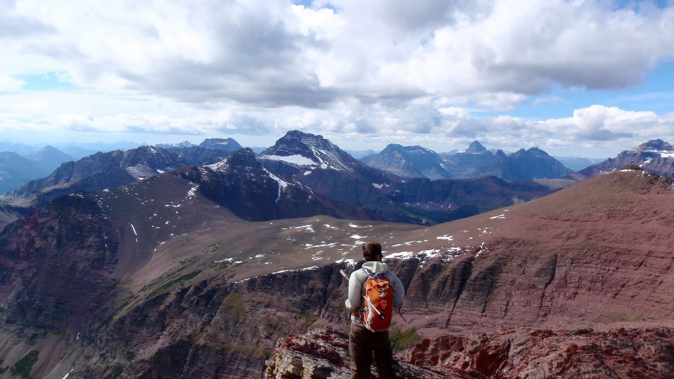
debating and arguing your point
modern computer-based
mapping
interpreting photos, cartoons, diagrams…
fieldwork
map skills
working with data
statistics
digital technologies
critical analysis
decision making
analysing articles
convincing others you are right
investigating issues in the real world
report writing
boosting your memory
problem solving
empathy
A wide variety of
SKILLS
Notes:
Such a wide variety of skills gained in Geography will be useful after school. These skills are highly sought after by Sixth Form Colleges, universities and employers.

Slide 5
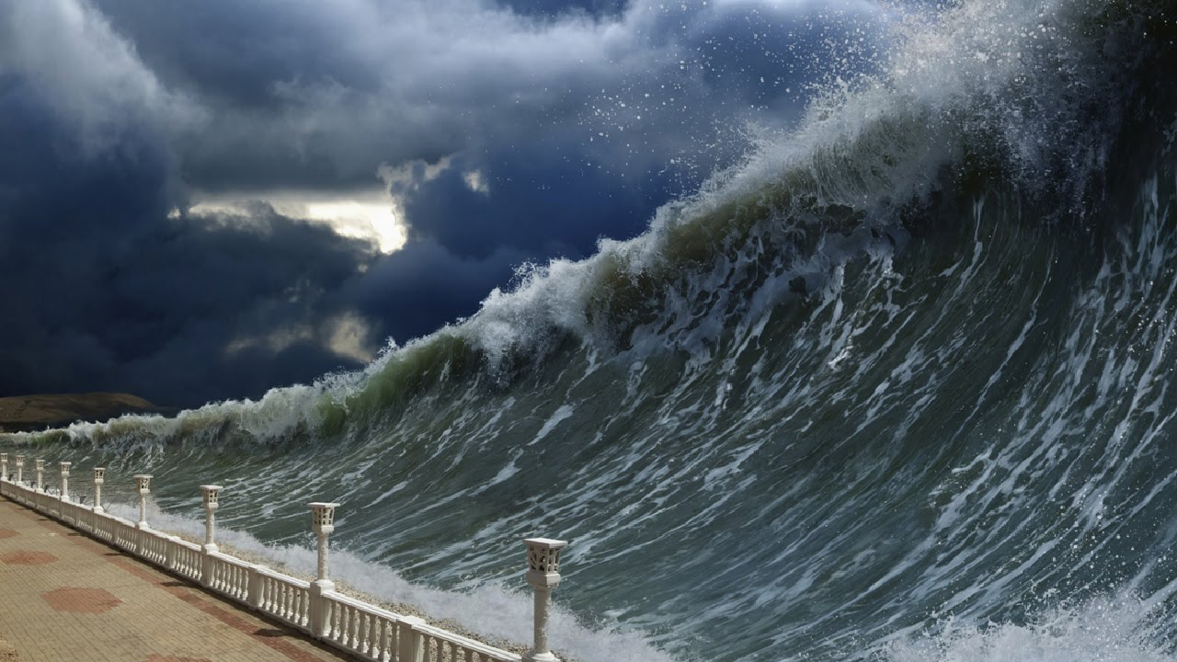
The Challenge of
NATURAL HAZARDS
Are earthquakes the deadliest natural hazard?
What if the UK was hit by a tsunami?
Notes:
You will learn about earthquakes, tsunami, hurricanes (how they’re caused, the effect on people and how people should respond)

Slide 6

Are cities in crisis?
What if there was no countryside?
Urban Issues and
CHALLENGES
Notes:
You will learn about two of the most important cities in the world today – London (UK) and Rio de Janeiro (Brazil)

Slide 7

The Challenge of
RESOURCE MANAGEMENT
What if all power was renewable?
Are we running out of resources?

Slide 8
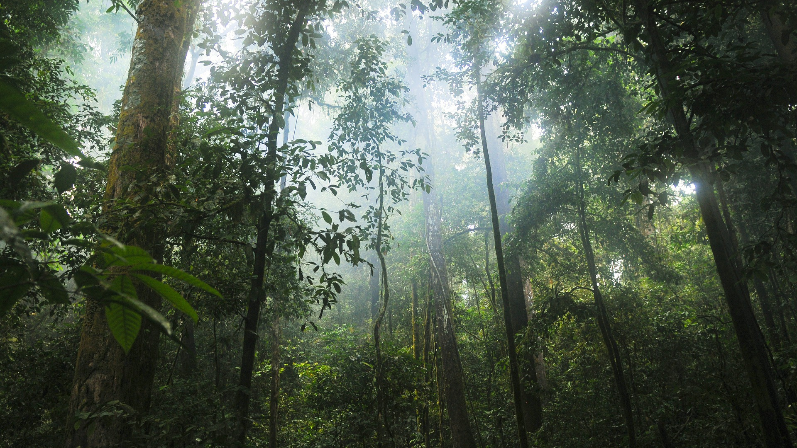
What if all the world’s rainforests were cut down?
How do plants and animals survive here?
The Living
WORLD
Notes:
Rainforests and Hot Desert Environments

Slide 9

Physical Landscapes
COASTS
Why are millions of properties at risk of falling into the sea?
How should we protect our coastlines?

Slide 10
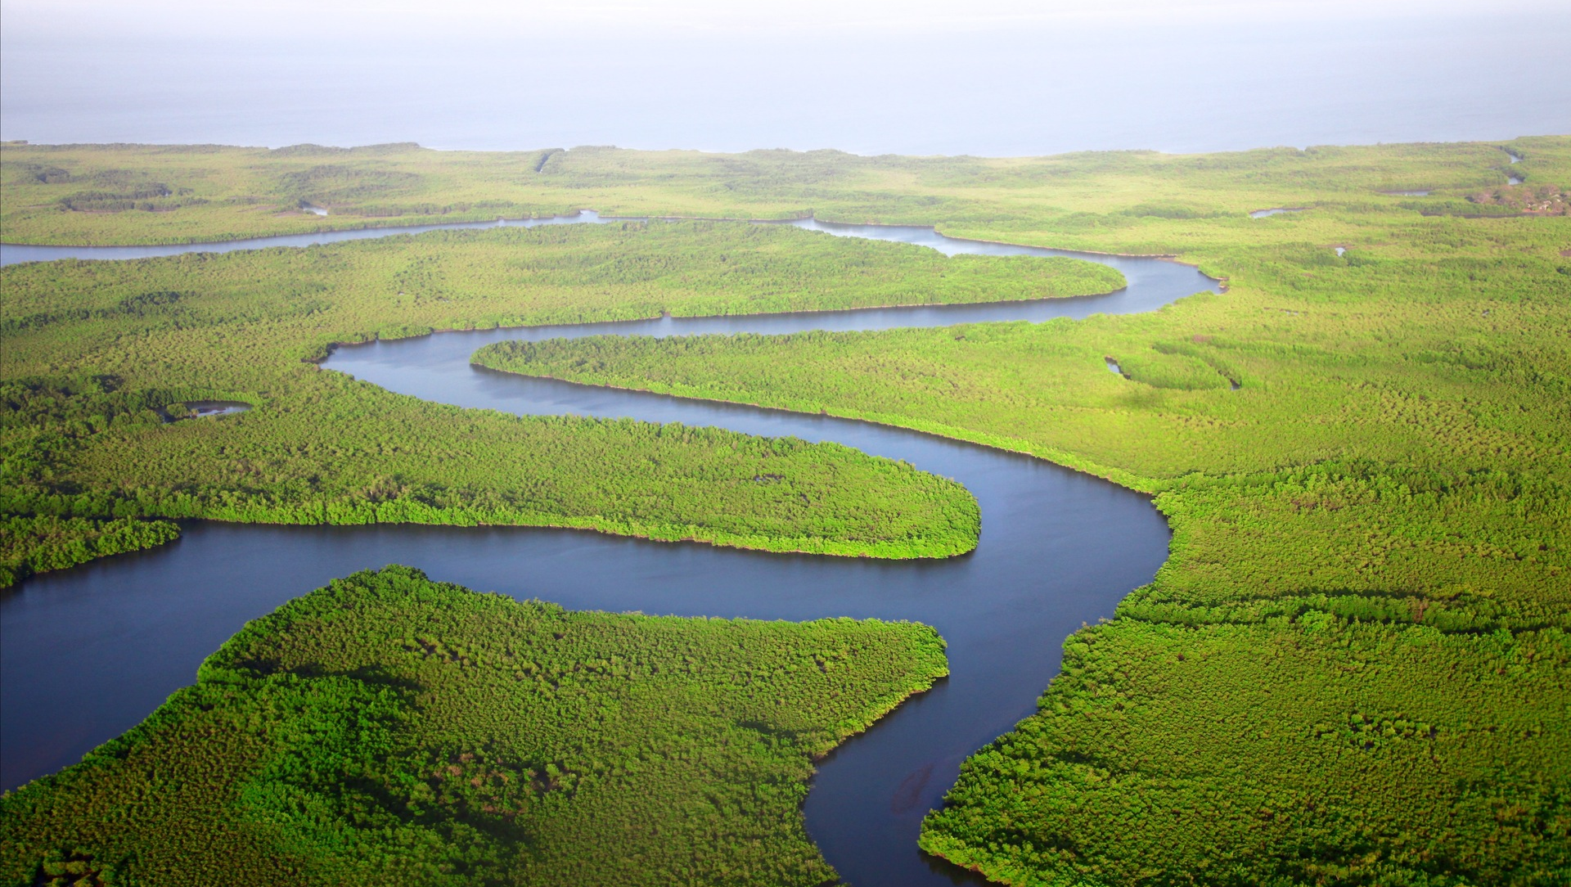
Why can rivers be deadly?
Why do people live near rivers that flood?
Physical Landscapes
RIVERS

Slide 11

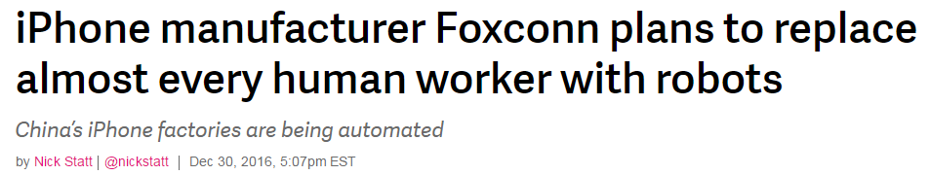
The Changing
ECONOMIC WORLD
What jobs will there be in the future?
How will new technology affect business and trade?
Notes:
Globalisation, business, jobs, technology, TNCs

Slide 12

Three examinations at the end of Year 11:
Unit 1 (1hr 30mins) tests Physical Geography (3 topics)
Unit 2 (1hr 30mins) tests Human Geography (3 topics)
Unit 3 (1hr 30mins) tests Fieldwork (2 trips) and contains a Decision-Making Exercise based on pre-release booklet
Notes:
We’ll do a lot of preparation for Unit 3 - good for those of you who do not like exams! Twelve weeks before the Unit 3 examination, a resources booklet will be released. This booklet will contain information about a current and controversial geographical issue. The Unit 3 examination will be based on this issue. Before you go into the Unit 3 exam, you will have a strong idea about the content and possible questions that may come up.

